Slide 1





Constitution
and
Constitutional
Convention
of 1787
© Erin Kathryn 2014

Slide 2

In the spring of 1787…
55 delegates traveled to Philadelphia, Pennsylvania
  A delegate is someone chosen to speak for others.
  Delegates came from every state except Rhode Island.
  Delegates were business people, landowners, and lawyers.
  Most were wealthy and educated.
  Many had served in Congress or state government.
  No women, African Americans, American Indians, or men who were not landowners took part in the convention.
They met to discuss how to change the
Articles of Confederation.
This meeting is now known as the
Constitutional Convention!
© Erin Kathryn 2014

Slide 3

Why Change?...
The Articles of Confederation did not give Congress enough power.
Some delegates wanted a federal system.
  In a federal system, the states and central government share power, but the central government has more power than the states.
© Erin Kathryn 2014

Slide 4
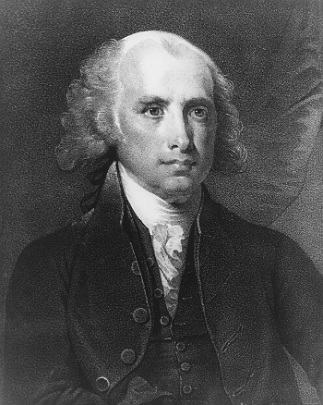
The Virginia Plan
  James Madison
  Believed a republic was the only type of government that could keep people’s rights while still keeping order and peace
    In a republic, citizens elect leaders to represent them.
  James Madison came up with a plan for the government called the Virginia Plan
  Under the Virginia Plan, the government would be split into three parts (or branches)
    Congress – would make laws
    Another branch would carry out these laws
    Another branch would settle legal arguments
© Erin Kathryn 2014

Slide 5
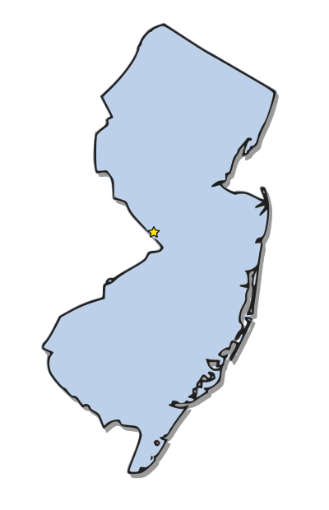
The new jersey Plan
  Delegates accepted most of the Virginia Plan, but did not like one part.
  Madison wanted the number of state representatives in Congress to be based off of each state’s population.
  This meant that a large state would get more votes than a smaller state.
  Smaller states did not like this because it meant larger states had more power.
  Delegates from small states created the New Jersey Plan.
  In the New Jersey Plan, each state would get one vote.
  Delegates argued over which plan should be used.
© Erin Kathryn 2014

Slide 6
The Great Compromise
Roger Sherman, a delegate from Connecticut, came up with a solution.
He suggested that Congress be divided into two parts, called houses.
  The Senate – each state would have an equal amount of representatives
  The House of Representatives – number of representatives would depend on the state’s population
Sherman’s idea was called
The Great Compromise.
© Erin Kathryn 2014

Slide 7
slavery
At the Constitutional Convention, delegates also argued over the issue of slavery.
  Southern delegates wanted slaves to count towards their population count because they would then have more representatives in Congress.
  Other delegates thought this was an unfair advantage, especially because slaves were treated like property rather than citizens.
Some delegates also argued to stop the practice of slavery in the United States.
  Southern delegates said they would not agree to the new government unless they were allowed to continue the practice of slavery.
© Erin Kathryn 2014

Slide 8


The three-fifths Rule
To settle the issue of slaves being a part of a state’s population, the Three-Fifths Rule was made.
  This meant that every 5 slaves would be counted as 3 free people.
It was also agreed that the slave trade would continue until 1808.
free
people
slaves
=
© Erin Kathryn 2014

Slide 9
Ratifying the constitution
The Constitution of the United States was signed on September17, 1787.
  It was based on James Madison’s Virginia Plan.
Before the Constitution could be used, it needed to be ratified by at least nine states.
  To ratify something means to accept it.
© Erin Kathryn 2014

Slide 10

federalists
Supporters of the Constitution
They had to teach the public about the Constitution because people were shocked that instead of making changes to the Articles of Confederation, an entirely new government plan was made.
© Erin Kathryn 2014

Slide 11
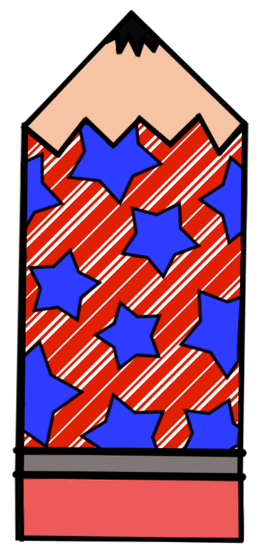
The Federalist
To help teach the people about the Constitution, James Madison, Alexander Hamilton, and John Jay wrote a series of essays called The Federalist.
These essays helped explain how the system would work and why it was so important for the new nation to have a federal system.
The Federalist essays emphasized a strong central government and how one would be created by the Constitution.
© Erin Kathryn 2014

Slide 12

Antifederalists
People who were against the Constitution were called Antifederalists.
They felt that a strong central government was a threat to their liberty.
They were concerned that the Constitution had no Bill of Rights.
  The Bill of Rights listed the rights of individuals.
© Erin Kathryn 2014

Slide 13
Ratifying the constitution
State representatives each met in their own meetings.
Delaware was the first to ratify, or accept, the Constitution.
In June 1788, New Hampshire was the ninth state to ratify the Constitution.
  Remember, nine states needed to ratify the Constitution before it could be used.
In the end, all 13 states ratified the Constitution.
© Erin Kathryn 2014

Slide 14

Important
People
© Erin Kathryn 2014

Slide 15
James Madison
Delegate from Virginia
Member of Congress
Wanted to do more than change
the Articles of Confederation
Had a plan for the new government,
called the Virginia Plan.
Wrote essays called The Federalist to
help people better understand
the Constitution.
© Erin Kathryn 2014

Slide 16
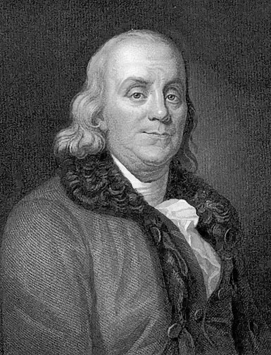
Benjamin Franklin
Delegate from Pennsylvania
Felt executive power was too big to be placed in the hands of one person
Felt a committee would be better
Helped delegates reach a compromise at the Constitutional Convention on many different topics
© Erin Kathryn 2014

Slide 17
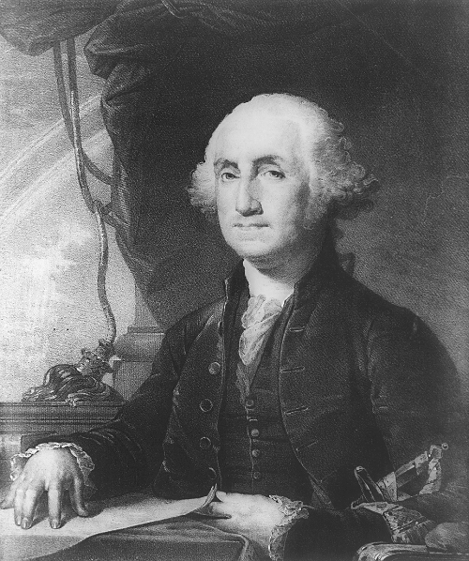
George Washington
Delegate from Virginia
President of the Convention
  Voted by delegates
Favored a strong central
government
Was elected as the First President
of the United States
© Erin Kathryn 2014

Slide 18
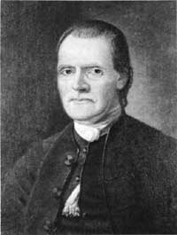
Roger Sherman
Delegate from Connecticut
Suggested dividing Congress
into two parts, called houses.
Sherman’s suggestion became
known as the Great
Compromise.
© Erin Kathryn 2014

Slide 19
Summary
Delegates met to discuss Articles of Confederation in 1787.
Instead, they wrote the Constitution, which was a new plan for the government.
It was based on James Madison’s Virginia Plan.
Delegates made several compromises before agreeing on a plan.
After Federalists and Antifederalists disagreed and argued, the Constitution was ratified in June of 1788.
© Erin Kathryn 2014

Slide 20
Why it matters…
The Constitutional Convention created the government in which the United States still has today!
© Erin Kathryn 2014

Slide 21
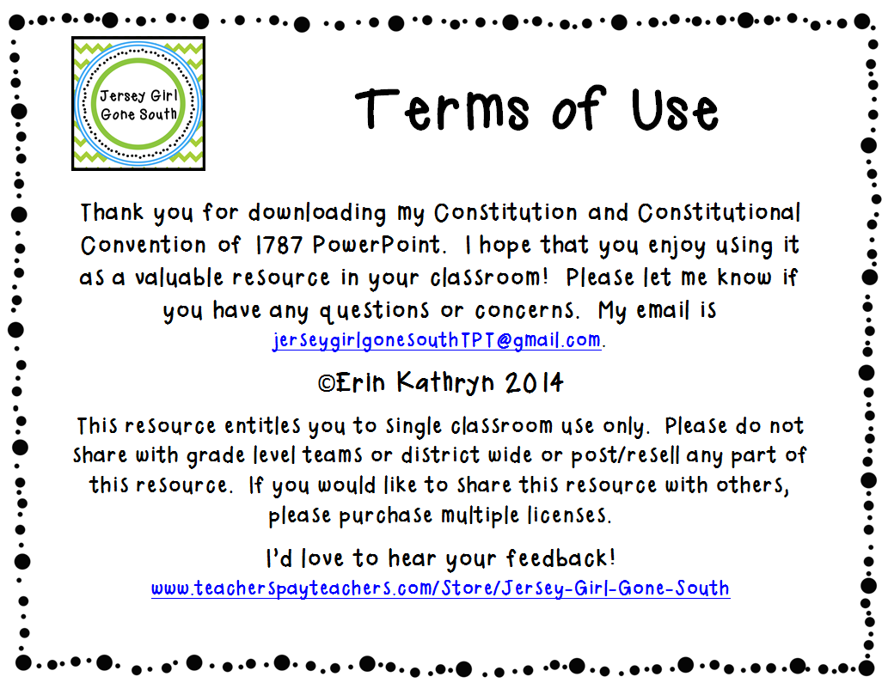

Slide 22
