Slide 1
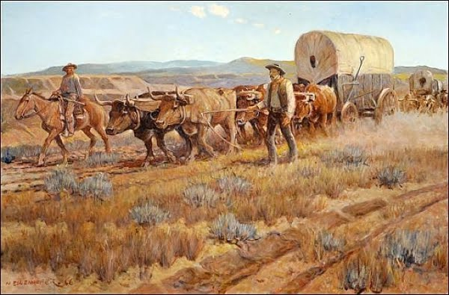
Westward Ho Pioneer Journal
Task: You are a pioneer traveling west. Are you looking for gold or to form a homestead? (This journal would be considered a primary source.)

Slide 2
Route/Transportation
What route are you taking?
Where do you plan to start?
Where do you plan to end?
What stops do you plan to make along the way? (give at least two)
What is your means of transportation? (give three details)

Slide 3
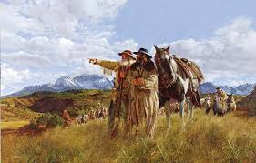
Purpose/People
What are you in search of?
What are you leaving behind?
Why are you choosing to leave?
Who will go with you? (name and describe two people)
Who will you meet along the way? (name and describe two people)

Slide 4
Risk/Challenges
What risk are you taking?
What challenges did you encounter along the way?(include three risks/challenges)
Did you make it to your intended destination?

Slide 5
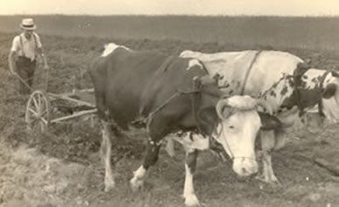
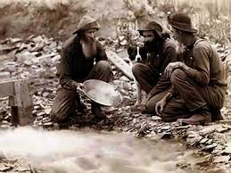
Resources/A Day in the Life
Name at least 6 items necessary to survive along the way.
How will you provide for yourself and your family? (list four details)
Describe a day in your new life as a goldminer or homesteader including details about morning, noon and night. Give details about chores, food, and work.

